Slide 1












MULTI-SENSOR BORDER TREAT DETECTION & CLASSIFICATION SYSTEM
PRESENTED BY;
JAISY SUNIL
JACOB THOMAS
HRIDHYA KRISHNA
ABEL YESUDAS
GROUP 13

Slide 2

Border surveillance is a critical requirement in modern defence systems
Threats can enter through:
Land (human intruders, vehicles)
Air (drones, UAVs)
3. Traditional single-sensor systems:
Generate false alarms
Fail to classify the type of intrusion
This project proposes a multi-sensor intelligent detection system

Slide 3

SYLLABUS

Slide 4

Detect intrusion in border areas effectively
Distinguish land-based and air-based threats
Reduce false alarms due to:
Birds
Animals
Environmental noise
4. Design a low-cost, scalable, student-level prototype

Slide 5
OBJECTIVES
Detect intrusion through land and air routes
Classify land intrusion as:
Human movement
Vehicle movement
Classify air intrusion as:
Drone
Bird / safe object
Implement sensor fusion for reliable decision making
provide real-time alerts with threat level indication

Slide 6









System overview
The proposed system consists of:
Ground vibration sensing unit
Acoustic sensing unit
Passive RF sensing unit
Embedded controller(Arduino/ESP32)
Display and alert unit
The system functions as a border surveillance node.

Slide 7
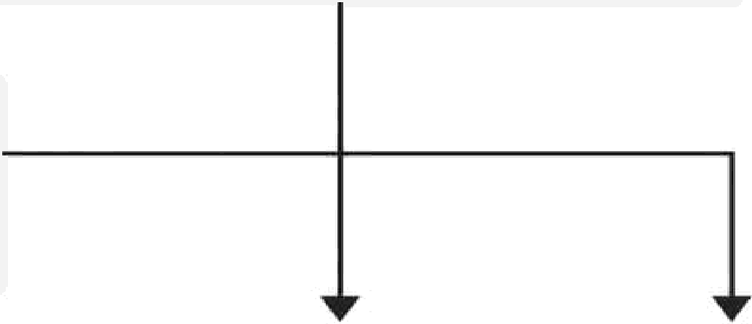

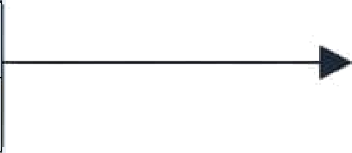
GROUND VIBRATION SENSOR
(Footstep / Vehicle)
ACOUSTIC SENSOR
(Microphone) (Drone / Bird Sound}
EMBEDDED CONTROLLER
PASSIVE RF SENSOR
(Arduino / ESP32)
Sensor Data Acqui sifion
- Pattern Recognition
Seeso r Fusion LDgie
- Threat CLassificafion
(Wireless Activity)
DISPLAY & ALERT UNIT
LCD / OLED Display
LED Indicators
Buzzer Alarm
POWER SUPPLY
(USB / Battery)
Al\ Modules

Slide 8
MAIN COMPONENTS REQUIRED
COMPONENTS | RATE | QUANTITY | COST
ESP 32 | Rs.450 | 1 | Rs. 450
SW 420 Module (vibration) | Rs 52 | 1 | Rs. 52
Sound sensor | Rs. 100 | 1 | Rs. 100
16x2 LCD with I2C | Rs. 150 | 1 | Rs. 150
Active Buzzer | Rs. 50 | 1 | Rs. 150

Slide 9
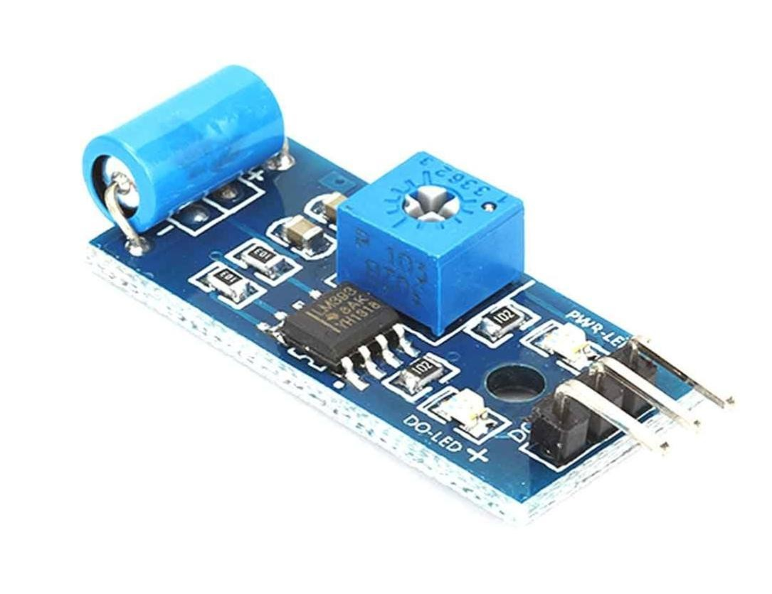
GROUND VIBRATION SENSOR (LAND DETECTION)
Detects mechanical vibrations on the ground
Used to identify land-based intrusions
Classification logic:
Low amplitude periodic vibrations→Human footsteps
High-amplitude continuous vibrations→Vehicle movement Output:
LAND:HUMAN
LAND:VEHICLE

Slide 10
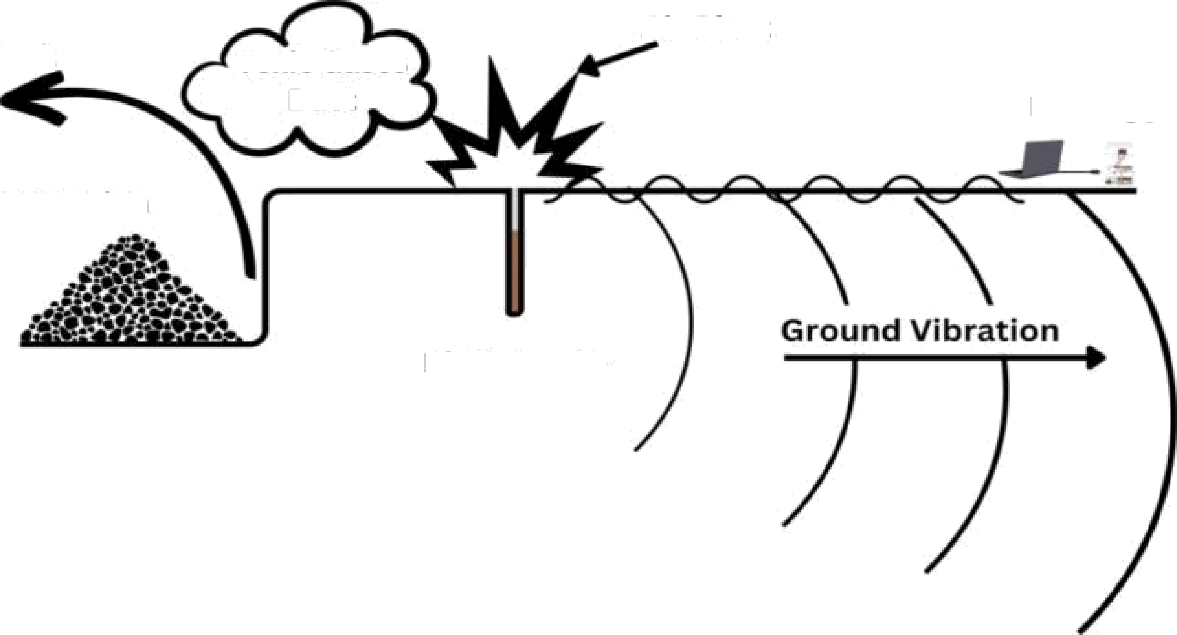
Air Btast
Fly Rock
Toxic Gases Dust
Prototype
Fragmentation
BLast Source

Slide 11
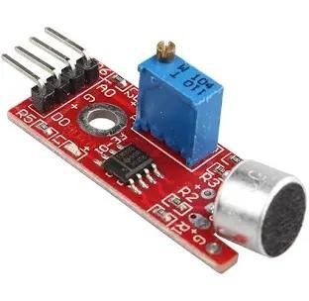
ACOUSTIC SENSOR (DRONE/BIRD DETECTION)
Uses a microphone to monitor sound
patterns
Drones generate steady buzzing sounds
Birds produce irregular, short-duration
chirps
Sound based Classification:
Continuous stable sound→Drone-like
Randompeaks→Bird/noise

Slide 12
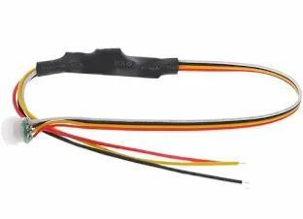
PASSIVE DETECTION UNIT
Monitors wireless signal activity in the surrounding
area
Drones relyon R F communication with controllers
High RF activity indicates: Possible drone control
signals and Suspicious air activity
Advantage:
Passive detection No signal transmission(stealthy)1q

Slide 13
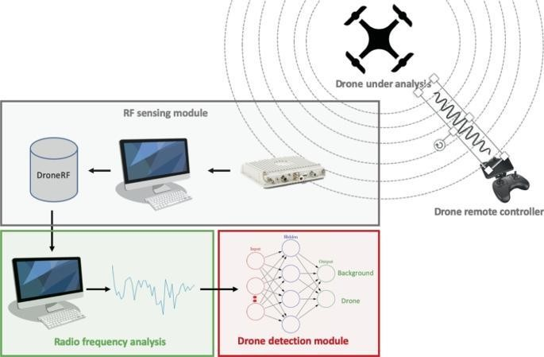

Slide 14
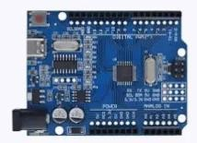
EMBBEDDED CONTROL UNIT
The system is implemented using:
Arduino or ESP32,based on availability
Functions of the controller:
Sensor data acquisition
Pattern recognition
Sensor fusion
Threat classification
Output control

Slide 15
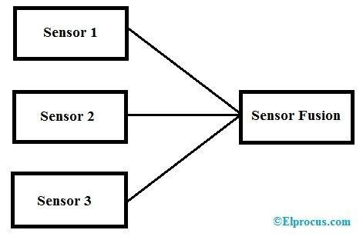
SENSOR FUSION CONCEPT
Individual sensors may generate false alarms
Combining multiple sensors improves accuracy
Example:
Rfactivity+drone-likesound→Drone conformed
Sound only→possible treat
NoRF+bird sound→Safe zone

Slide 16

DECISION LOGIC
Step1:Check ground vibration sensor
Step2:Check acoustic sensor
Step3:Check Rf activity
Step4:Apply classification rules
Step5:Display threatty peandalert level
This rule-based logic simulates defence decision systems.l

Slide 17
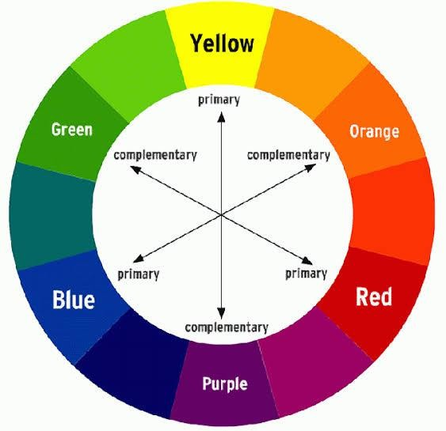
THREAD LEVEL CLASSIFICATION
Low Threat(Green):
Bird noise
No RF activity
Single sensor trigger
Medium Threat(Yellow):
High Threat(Red):
Confirmed drone
Vehicle movement

Slide 18
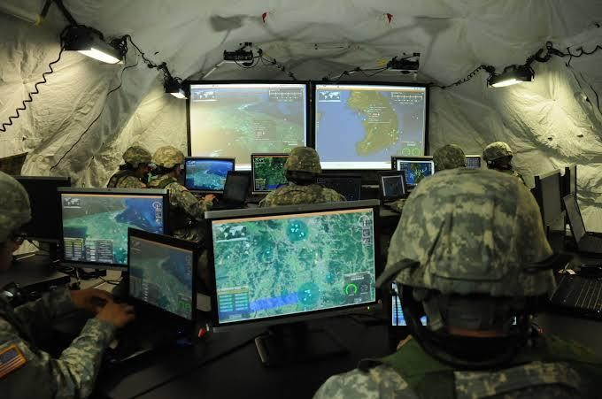
OUTPUT AND ALERT SYSTEM
LCD Display:
SAFEZONE
LAND:HUMAN
LAND:VEHICLE
AIR:DRONE CONFIRMED
LED Indicators:
Green→Safe
Yellow→Warning
Red→Danger
Buzzer for audible alert

Slide 19
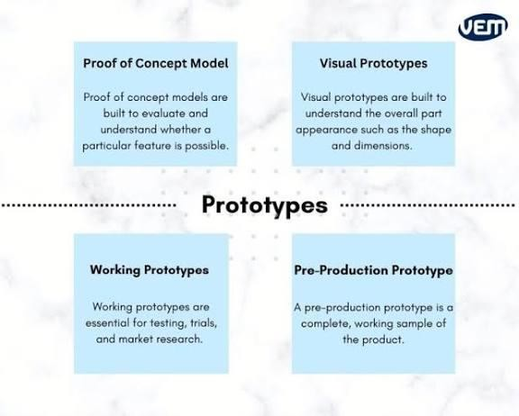
PROTOTYPE MODEL DESIGN
Ground section contains vibration sensor
Elevated tower contains acoustic and RFsensors
Control unit contains controller,LCD,and alerts
Designed to resemble a border
surveillance post

Slide 20

Low-costand compact
Reduced false alarms
Modular and scalable
Operates in low visibility conditions
Defence - oriented architec

Slide 21

Limited detection range
Basic sound classification
Environmental noise may affect accuracy
Prototype-level implementation

Slide 22
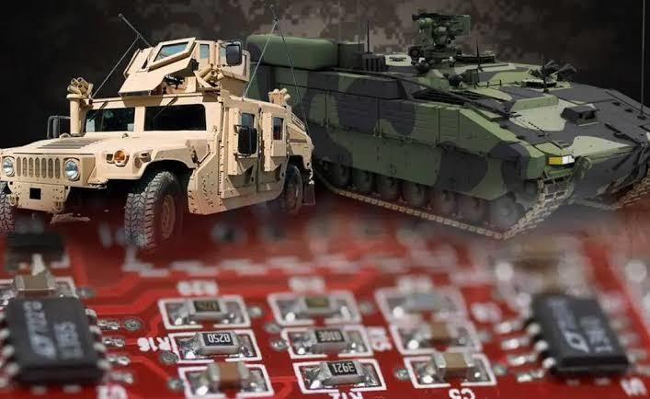
FUTURE SCOPE
AI based sound and vibration analysis
Long range communication (LoRa/ GSM)
Thermal detection for camouflaged intruders
Direction-based threat detection
Centralized monitoring dashboard

Slide 23

Multi-sensor approach improves intrusion detection accuracy
Sensor fusion enables intelligent threat classification
The prototype demonstrates are a realistic defence surveillance concept
Suitable for further research and real world expansion

Slide 24


